Slide 1
STATE OF TEXAS v CLAIRE JOHNSON

Slide 2
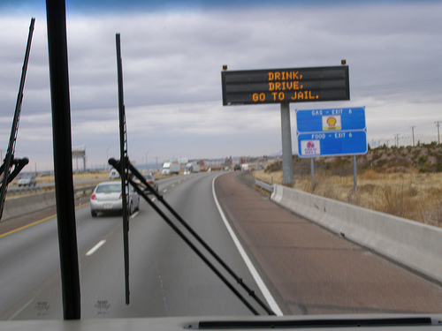
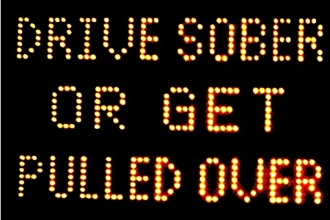
DRINKING
Drink, Drive, Go to Jail
Drive Sober or Get Pulled Over
Going Out Tonight, So Are We

Slide 4
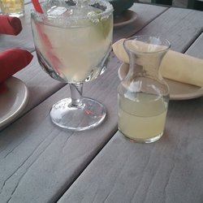
NOT ILLEGAL TO DRINK AND THEN DRIVE; as long as you’re NOT intoxicated

Slide 5
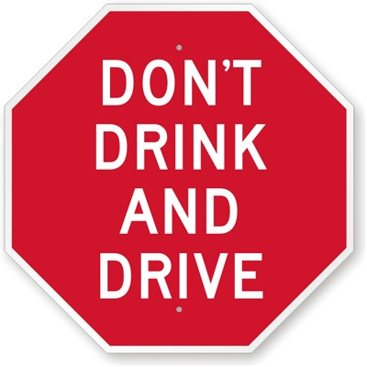
BUT…

Slide 6
DRINKING PATTERNS
A. REGULARLY
B. OCCASIONALLY
C. RARELY
D. NEVER
E. NOT ANY MORE

Slide 7
ALCOHOL
MEMBER OF MADD
MEMBER OF AA
STRONGLY AGREE WITH “NO REFUSAL” WEEKENDS
ALCOHOLISM IN FAMILY
NO ALCOHOL IN HOME
INJURED/VICTIM OF ALCOHOL RELATED CRIME

Slide 8
WHO KNEW?
DWI with a Child >15
=
STATE JAIL FELONY?

Slide 9
WHO HAS?
CONSUMED ALCOHOL AND THEN DRIVEN IN THE PAST YEAR?

Slide 10
WHO HAS?
CONSUMED ALCOHOL AND THEN DRIVEN IN THE PAST YEAR WITH A CHILD IN THE CAR?

Slide 11
RELATED TO?

Slide 12
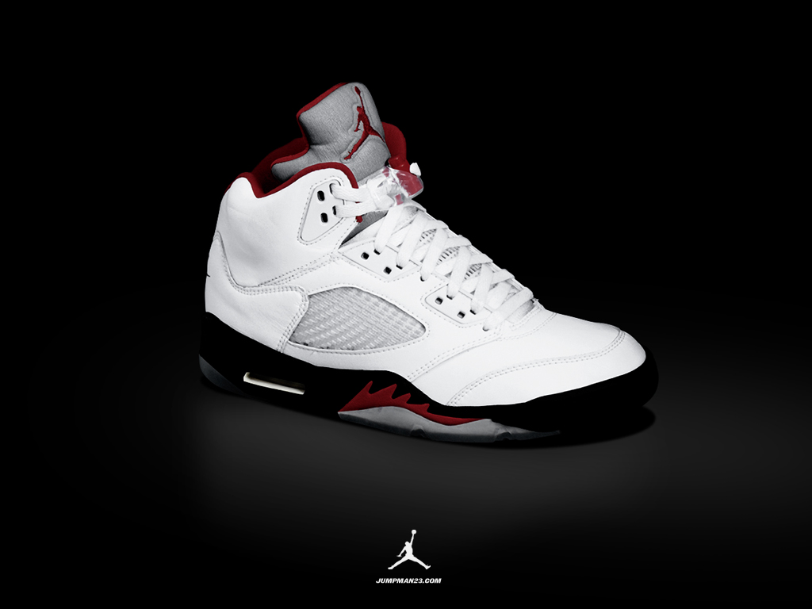
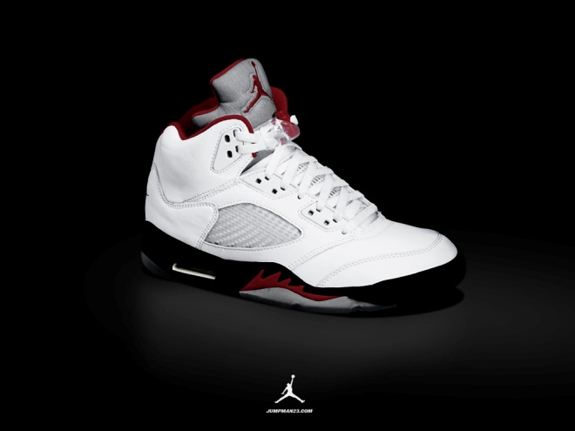
NORMAL v AVERAGE
SIZE 6 SIZE 10

Slide 14
AT THE TIME OF DRIVING
Retrograde Extrapolation
Factors that Can Affect This?

Slide 15
HOW DO YOU FEEL ABOUT POLICE LABS?
NEVER ALWAYS

Slide 16
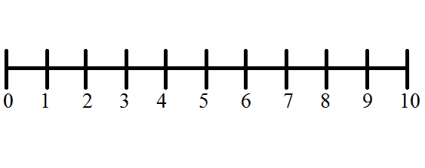
PRESUMPTION OF INNOCENCE
INNOCENT GUILTY

Slide 18
THE LAW
“NOT GUILTY” if
Operation not proven Beyond a Reasonable Doubt
“NOT GUILTY” if
Intoxication not proven Beyond a Reasonable Doubt
“NOT GUILTY” if
ANY of the elements alleged not proven Beyond a Reasonable Doubt
Notes:
Do you understand that is the law ?
Can you commit to me that ...?
Everyone seen the signs “if you drink, don’t drive”
Recognize that is NOT the law ?
Does anyone believe that the law should be that way ?

Slide 19
PURPOSES OF PUNISHMENT
Rehabilitation
Train, educate, assist to enable offender to live productive life
Deterrence
Keep offender and others from committing similar offenses in the future
Retribution
Old Testament: “Eye for an Eye”
Notes:
Duty to talk about it now
Hope and believe that we will not get there, but law requires it to be discussed now
Two Possible Phases to a trial
Guilt innocence
Punishment
Seat Belt
Insurance

Slide 20
BENEFITS OF PROBATION
What are some of the benefits of placing someone on probation for an offense as opposed to sending them to prison ?
Notes:
Studies have shown that people with a strong family support and who complete treatment and counseling programs are much less likely to commit another crime, than those who complete a prison sentence. Juror #3, do you agree or disagree with these studies?

Slide 21
PUNISHMENT
DWI with a CHILD (STATE JAIL FELONY)
6mos-2 Years STATE JAIL
or
2-10 Years Probation

Slide 22
PUNISHMENT
DWI (Class B Misdemeanor)
3-180 Days Jail
or
12 Months Probation

Slide 23
PUNISHMENT FACTORS
AGE
PRIOR BACKGROUND
INTENTIONAL OR ACCIDENT
CONDUCT DURING EVENT
FEELINGS OF FAMILY MEMBERS
LIKELIHOOD OF RE-OFFENDING
LIKELIHOOD OF COMPLYING WITH PROBATION
PRE-TRIAL BEHAVIOR

Slide 24
“GOLDEN RULE QUESTION”
Is there ANY reason you do not believe you can be a fair and impartial juror in THIS case ?
Would you want 12 people who felt and thought the same way you do acting as jurors in a case where a friend or relative was charged with this offense ?
Notes:
Cover DC Objections

Slide 25
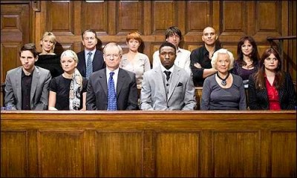
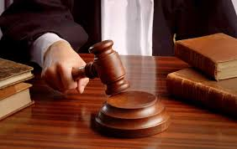
JURY SERVICE

Slide 26
THANK YOU

